Slide 1
Level of happiness in the Kazakhstan
Saparbay Beibarys
b_saparbai@kbtu.kz
KBTU, FIT, IS, 2year

Slide 2

Plan:
Info;
Happiness;
Problems;
Conclusion;
Sources;

Slide 3
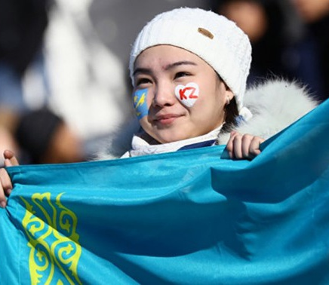
Info
Kazakhstan took the 7th place with 74% in the index of happiness, which conducted by the IIRAG(International Independent Research Agency Gallup);
54k people from 55 countries took part in the survey;

Slide 4
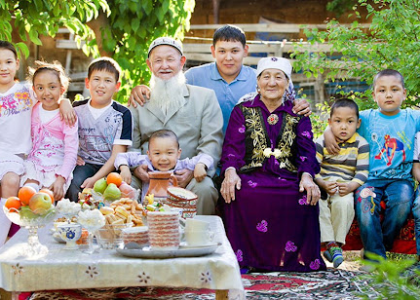
Happiness Part1
Muslims;
If you are part of islam, you will recognize a meaning of life. And you will recognize happiness in not money, happiness is family, your wife, friends, and precisely connection with Allah(namaz or praying );

Slide 5
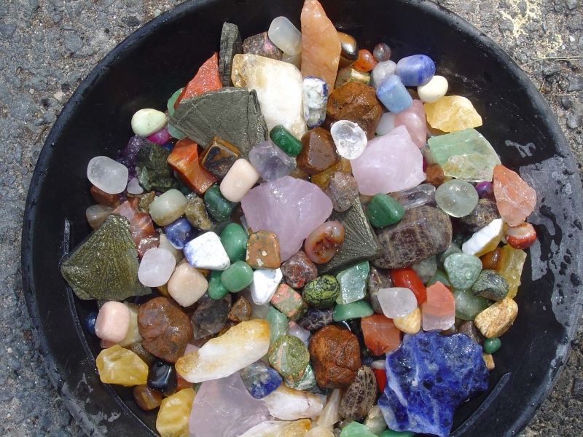
Happiness Part2
As we are in 9th place of big countrie, We have more treasure as oil,gas etc.
We have 99 elements of Periodic table;
It means we have more treasure
treasure ->money -> solving a problem -> happy;

Slide 6
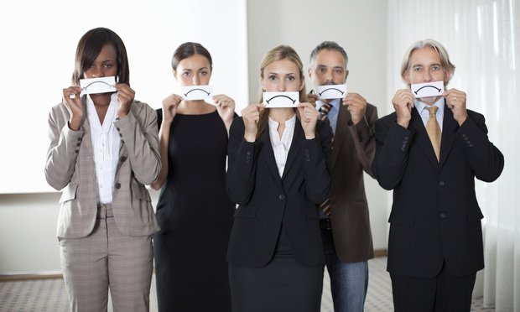
Worse?Why?
Corruption – One of the most problems in Kazakhstan.Because of corruption, money didn’t reach to the destination,for example for studies,schools;
Familiar(Таныс) – if you don’t have bro(bratan) you have less chance than who has a brother(bratan).For example:In some work you are going to hire(you are smartest), but there appears a person(stupid,but have brother).and he will hired up to the work;

Slide 7
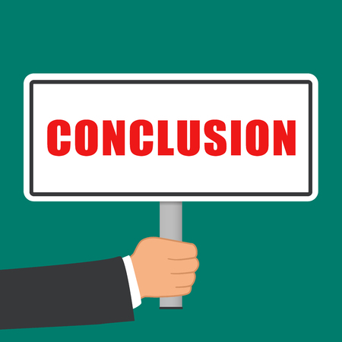
Conclusion
We know that money is not happiness, but money can affect to happiness, we are muslims(I talked about in 4page of ppt);
So we have money, that can solve a problems, which we have;

Slide 8
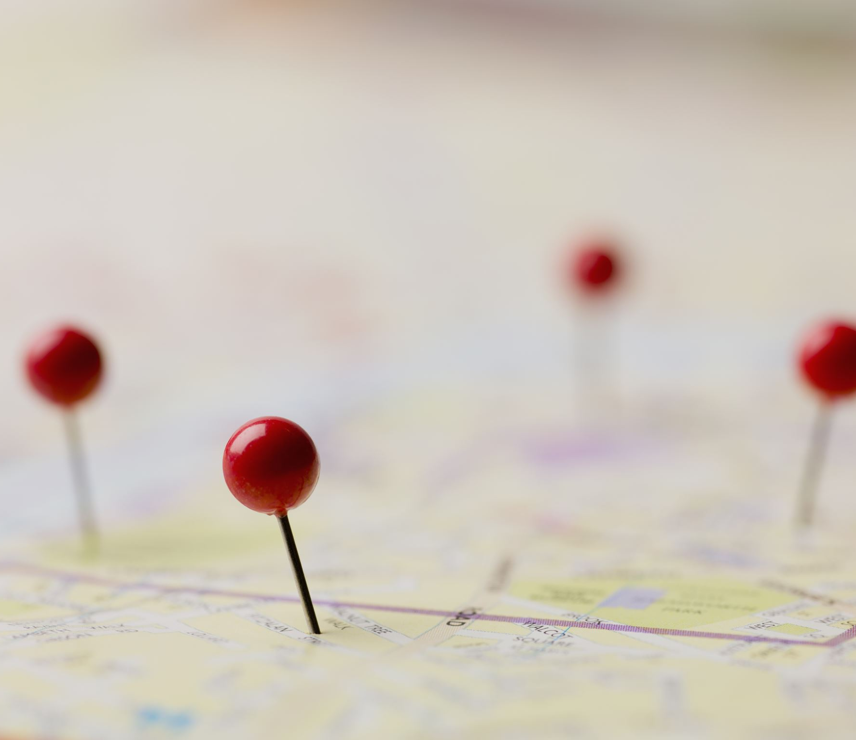
Sources:
https://qazaqtimes.com/en/article/33990

